Slide 1



Lecture 15 ARM interrupts and Interrupt-Driven Ping-Pong
References on Interrupts
Exceptions, Interrupts, Vector Table, Handlers
How to Use Interrupts on the Zynq SoC
interrupt_counter_tut_2B.c
AXI GPIO Core and Interrupt
AXI Timer and Interrupt
Lab #8 Interrupt-Driven LED Ping-Pong Game on Zybo

Slide 2
References on Interrupts
How to Use Interrupts on the Zynq SoC, Xcell Journal 87
ARM® Generic Interrupt Controller, Architecture version 2.0, Architecture Specification, 2013
Chapter 3 Interrupt Controller, Cortex™-A9 MPCore Revision: r2p2, Technical Reference Manual, ARM DDI 0407F
General purpose I/O (XGpio) device drivers, gpio v4_0, Xilinx.
xil_exception.c,standalone_v4_2, from C:\Xilinx\SDK\2014.4\data\embeddedsw\lib\bsp\standalone_v4_2\src\cortexa9
The_Zynq_Book_Tutorials, v1.2 - September 2014, University of Strathclyde, Glasgow, Scotland, UK
Altera: Using the ARM Generic Interrupt Controller For Quartus II 14.0
AXI GPIO v2.0, LogiCORE IP Product Guide, Vivado Design Suite, PG144 November 18, 2015
AXI Timer v2.0, LogiCORE IP Product Guide, Vivado Design Suite, PG079 November 18, 2015

Slide 3
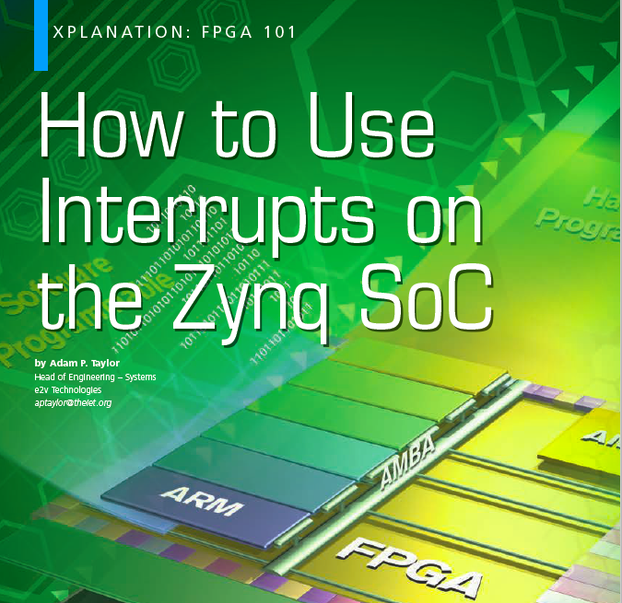
Recommended Reading Materials on Interrupts
How to Use Interrupts on the Zynq SoC, Xcell Journal 87
The ZYNQ Book
Chapter 10.4 Interrupts
Altera : Introduction to the ARM® Processor Using Altera Toolchain, Altera Corporation University Program, April 2014
ARM Generic Interrupt Controller – Architecture Specification
Chapter 1: Introduction
Chapter 2: GIC Partitioning
Chapter 3: Interrupt Handling and Prioritization
Chapter 4: Programmers’ Model

Slide 4
Exceptions from the ARM Architecture Reference Manual
ARM supports five types of exceptions, and a privileged processing mode for each type
Fast interrupt
Normal interrupt
Memory aborts
Attempted execution of an undefined instruction
Software interrupt (SWI) instructions
The exception process
When an exception occurs, the ARM processor halts execution after the current instruction and begins execution at one of a number of fixed addresses in memory, known as the exception vectors, one for each exception.
The exception vector stores the starting address of the handler, a subroutine, for an exception
The handler is loaded and ready to run
How to Use Interrupts on the Zynq SoC, Xcell Journal 87

Slide 5
Exceptions, Vector Table, Handlers, Interrupts
Exceptions:
ARM calls all special events “Exceptions” because they are exceptions to the normal instruction execution
Vector Table
ARM has a fixed address table (vector table) to store the starting addresses of subroutines, handlers, to serve exceptions
Handlers – interrupt service routines
The vector table needs to be initialized with right handlers
Interrupts
External peripherals, devices and software call their special events “Interrupts” because they interrupt the normal program execution of ARM
How to Use Interrupts on the Zynq SoC, Xcell Journal 87

Slide 6
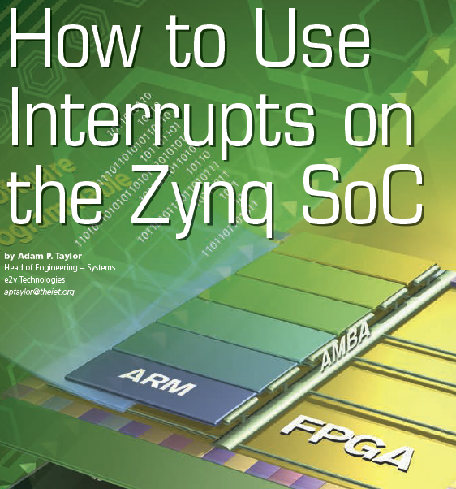
PROCESSING THE INTERRUPTS ON THE ZYNQ SOC
1. The interrupt is shown as pending.
2. The processor stops executing the current thread.
3. The processor saves the state of the thread in the stack to allow processing to continue once it has handled the interrupt.
4. The processor executes the interrupt service routine, which defines how the interrupt is to be handled.
5. The processor resumes operation of the interrupted thread after restoring it from the stack
How to Use Interrupts on the Zynq SoC, Xcell Journal 87

Slide 7
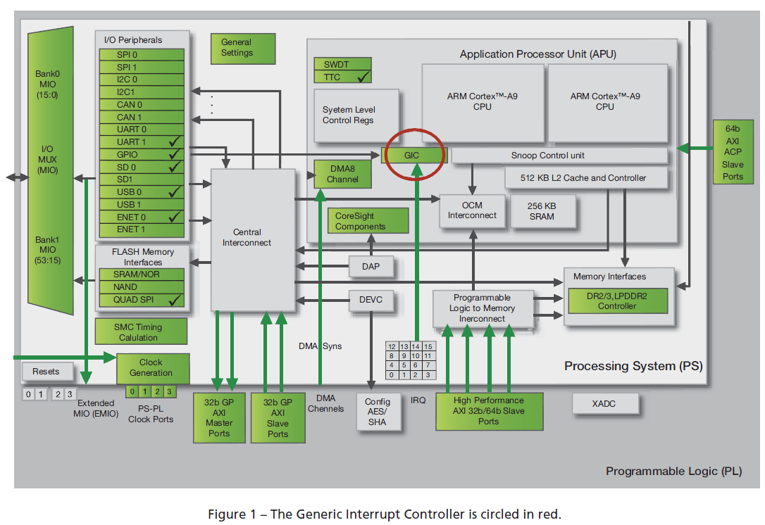
ARM® Generic Interrupt Controller (GIC)
How to Use Interrupts on the Zynq SoC, Xcell Journal 87

Slide 8
Interrupt Sources: 16+44+16+5=81
Software-generated interrupts
16 such interrupts for each processor. They can interrupt one or both of the Zynq SoC’s ARM® Cortex™-A9 processor cores.
Shared peripheral interrupts
60 interrupts can come from the I/O peripherals, or to and from the programmable logic (PL) side of the device. They are shared between the Zynq SoC’s two CPUs.
44 interrupts can be routed to either CPU from the I/O peripherals.
16 interrupts can be routed from the PL.
Private peripheral interrupts
5 interrupts in this category are private to each CPU—for example CPU timer, CPU watchdog timer and dedicated PL-to-CPU interrupt.
How to Use Interrupts on the Zynq SoC, Xcell Journal 87

Slide 9
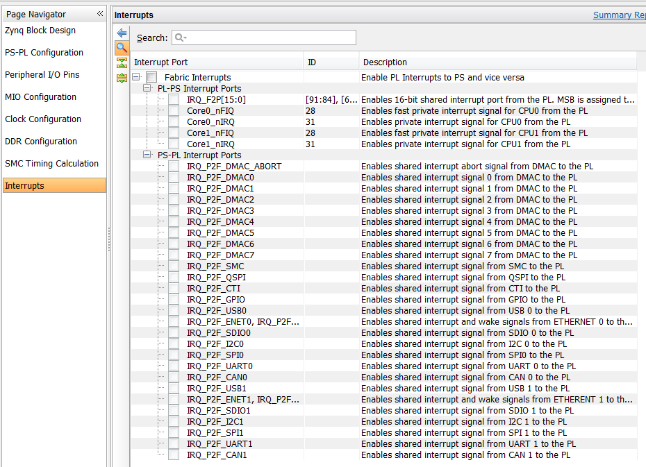
How to Use Interrupts on the Zynq SoC, Xcell Journal 87

Slide 10
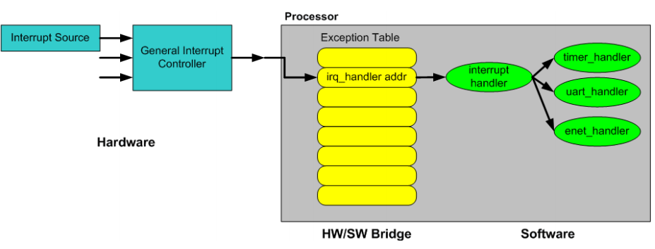

Flow of Interrupt Handling Process and Configuration
Interrupt Source
Generic Interrupt Controller
Exception Vector Table stores the starting address (vector) of the handler

Slide 11
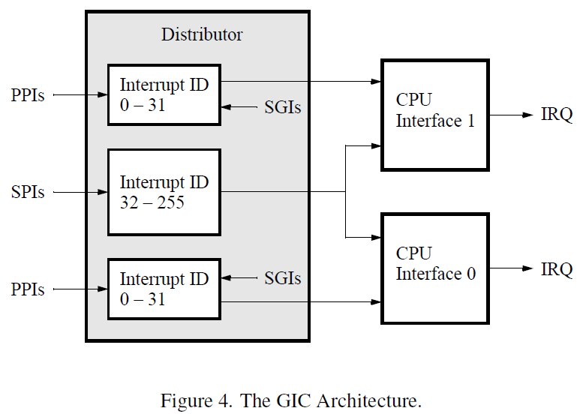
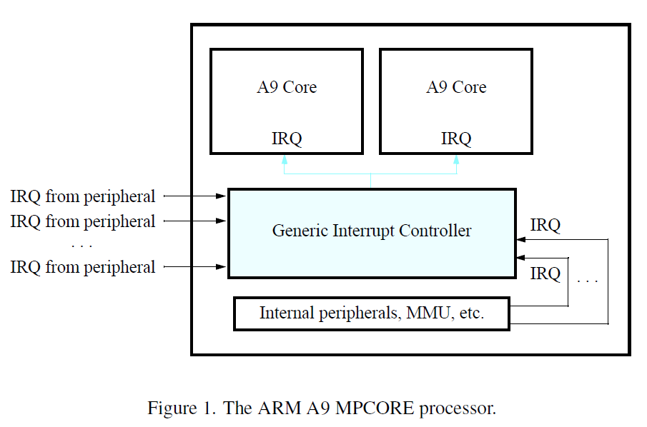
Three Levels of Interrupt Configurations with A9 Core, GIC, Interrupts
A9 Core stores the exception vector table and knows which exception handler to use for each interrupt. Exception table needs to be initialized with exception handlers.
GIC knows how interrupts are configured and when to send an interrupt to an A9 Core.
Each interrupt needs to be configured.
Altera: Using the ARM Generic Interrupt Controller For Quartus II 14.0

Slide 12
Interrupt Configuration for A9 Core in xil_exception.h
extern void Xil_ExceptionRegisterHandler(u32 id, Xil_ExceptionHandler handler, void *data);
Install handler for id
extern void Xil_ExceptionRemoveHandler(u32 id);
extern void Xil_ExceptionInit(void);
extern void Xil_DataAbortHandler(void *CallBackRef);
extern void Xil_PrefetchAbortHandler(void *CallBackRef);
Altera: Using the ARM Generic Interrupt Controller For Quartus II 14.0

Slide 13
Interrupt Configuration for GIC in xscugic.h
int XScuGic_Connect(XScuGic *InstancePtr, u32 Int_Id, Xil_InterruptHandler Handler, void *CallBackRef);
void XScuGic_Disconnect(XScuGic *InstancePtr, u32 Int_Id);
void XScuGic_Enable(XScuGic *InstancePtr, u32 Int_Id);
void XScuGic_Disable(XScuGic *InstancePtr, u32 Int_Id);
int XScuGic_CfgInitialize(XScuGic *InstancePtr, XScuGic_Config *ConfigPtr, u32 EffectiveAddr);
int XScuGic_SoftwareIntr(XScuGic *InstancePtr, u32 Int_Id, u32 Cpu_Id);
void XScuGic_GetPriorityTriggerType(XScuGic *InstancePtr, u32 Int_Id, u8 *Priority, u8 *Trigger);
void XScuGic_SetPriorityTriggerType(XScuGic *InstancePtr, u32 Int_Id,u8 Priority, u8 Trigger);
XScuGic_Config *XScuGic_LookupConfig(u16 DeviceId);
void XScuGic_InterruptHandler(XScuGic *InstancePtr);

Slide 14
Interrupt Configuration for XGPIO in xgpio.h
void XGpio_InterruptGlobalEnable(XGpio *InstancePtr);
void XGpio_InterruptGlobalDisable(XGpio *InstancePtr);
void XGpio_InterruptEnable(XGpio *InstancePtr, u32 Mask);
void XGpio_InterruptDisable(XGpio *InstancePtr, u32 Mask);
void XGpio_InterruptClear(XGpio *InstancePtr, u32 Mask);
u32 XGpio_InterruptGetEnabled(XGpio *InstancePtr);
u32 XGpio_InterruptGetStatus(XGpio *InstancePtr);
Altera: Using the ARM Generic Interrupt Controller For Quartus II 14.0

Slide 15
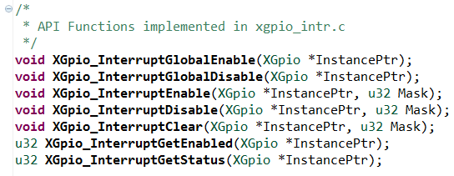
API Functions implemented in xgpio_intr.c
void XGpio_InterruptGlobalEnable(XGpio *InstancePtr);
void XGpio_InterruptGlobalDisable(XGpio *InstancePtr);
void XGpio_InterruptEnable(XGpio *InstancePtr, u32 Mask);
void XGpio_InterruptDisable(XGpio *InstancePtr, u32 Mask);
void XGpio_InterruptClear(XGpio *InstancePtr, u32 Mask);
u32 XGpio_InterruptGetEnabled(XGpio *InstancePtr);
u32 XGpio_InterruptGetStatus(XGpio *InstancePtr);
How to Use Interrupts on the Zynq SoC, Xcell Journal 87

Slide 16
Interrupt Configuration for AXI Timer in xtmrctr.h
int XTmrCtr_Initialize(XTmrCtr * InstancePtr, u16 DeviceId);
XTmrCtr_Config *XTmrCtr_LookupConfig(u16 DeviceId);
void XTmrCtr_SetResetValue(XTmrCtr * InstancePtr, u8 TmrCtrNumber, u32 ResetValue);
void XTmrCtr_SetHandler(XTmrCtr * InstancePtr, XTmrCtr_Handler FuncPtr, void *CallBackRef);
void XTmrCtr_SetOptions(XTmrCtr * InstancePtr, u8 TmrCtrNumber, u32 Options);
int XTmrCtr_IsExpired(XTmrCtr * InstancePtr, u8 TmrCtrNumber);
void XTmrCtr_Start(XTmrCtr * InstancePtr, u8 TmrCtrNumber);
void XTmrCtr_Stop(XTmrCtr * InstancePtr, u8 TmrCtrNumber);
Altera: Using the ARM Generic Interrupt Controller For Quartus II 14.0

Slide 17
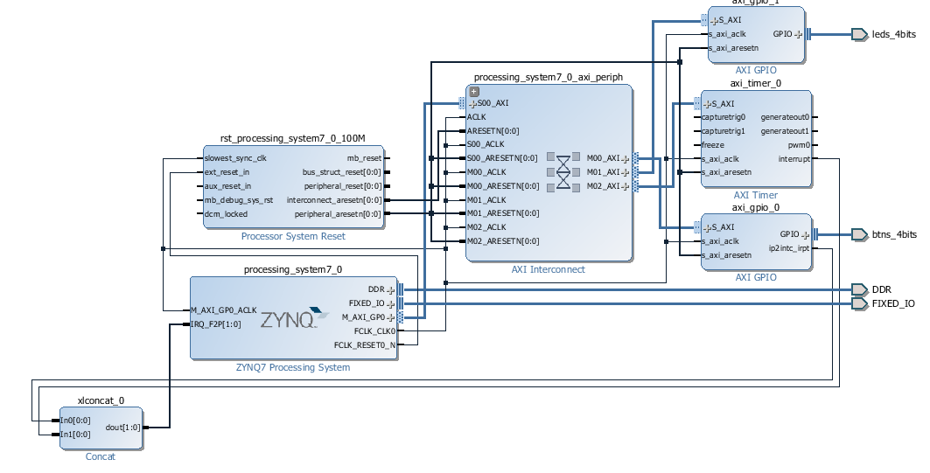
Zynq_Book_Tutorials 2, The_Zynq_Book_Tutorials, v1.2
Four LEDs as a four-bit counter
Four push buttons – interrupt driven to show button pressing on LED
AXI Timer – interrupt driven to increase LED counter
interrupt_counter_tut_2D.c
The_Zynq_Book_Tutorials, v1.2

Slide 18
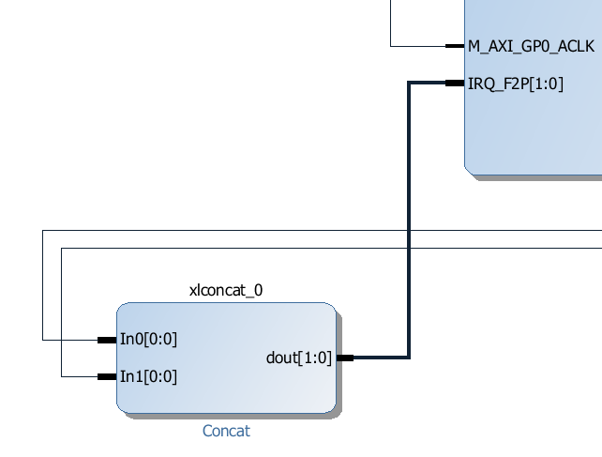
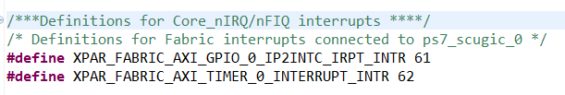
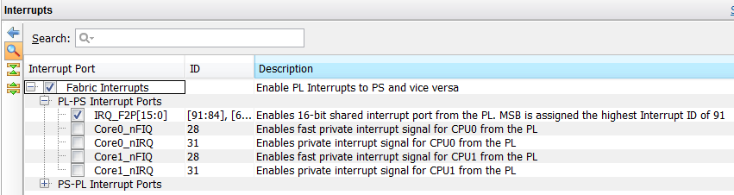
Zynq_Book_Tutorials 2: Interrupt Hardware Configuration
IRQ_F2P[1:0]
In0[0:0] – axi_gpio_0
In1[0:0] – axi_timer_0
Exported to xparameters.h file

Slide 19
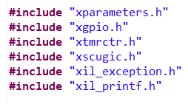
The board support package (BSP) and Interrupts on the Zynq SoC
Xparameters.h – Zybo board
This file contains the processor’s address space and the device IDs.
Xscugic.h – Generic Interrupt Controller
The generic interrupt controller driver component.
This file holds the drivers for the configuration and use of the GIC.
SCU stands for Snoop Control Unit.
Xil_exception.h – Cortex A9
This header file contains ARM Cortex A9 specific exception related APIs.
xtmrctr.h – AXI Timer
This component supports the Xilinx AXI timer/counter.
xgpio.h
Xilinx General Purpose I/O (XGpio) device driver.
How to Use Interrupts on the Zynq SoC, Xcell Journal 87

Slide 20
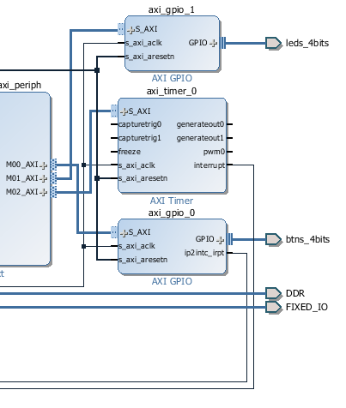
Device IDs and Device Instances
Device IDs in xparameter.h
#define INTC_DEVICE_ID XPAR_PS7_SCUGIC_0_DEVICE_ID
#define TMR_DEVICE_ID XPAR_TMRCTR_0_DEVICE_ID
#define BTNS_DEVICE_ID XPAR_AXI_GPIO_0_DEVICE_ID
#define LEDS_DEVICE_ID XPAR_AXI_GPIO_1_DEVICE_ID
#define INTC_GPIO_INTERRUPT_ID XPAR_FABRIC_AXI_GPIO_0_IP2INTC_IRPT_INTR
#define INTC_TMR_INTERRUPT_ID XPAR_FABRIC_AXI_TIMER_0_INTERRUPT_INTR
LEDs, Push buttons
XGpio LEDInst, BTNInst;
GIC
XScuGic INTCInst;
AXI Timer
XTmrCtr TMRInst;

Slide 21
Flow of Interrupt Handling Process and Configuration
Interrupt Source
Generic Interrupt Controller
Exception Vector Table stores the starting address (vector) of the handler

Slide 22
Initialize the Cortex A9 Exceptions
Xil_ExceptionInit(); - empty routine for Cortex-A9
void Xil_ExceptionRegisterHandler(u32 exception_id, Xil_ExceptionHandler Handler, void *Data)
exception_id contains the ID of the exception source
Handler to the Handler for that exception.
Data is a reference to Data that will be passed to the Handler
#define Xil_ExceptionEnable() \ Xil_ExceptionEnableMask(XIL_EXCEPTION_IRQ)
void Xil_ExceptionRegisterHandler(u32 exception_id,
Xil_ExceptionHandler Handler,
void *Data)
{
XExc_VectorTable[exception_id].Handler = Handler;
XExc_VectorTable[exception_id].Data = Data;
}

Slide 23
Initialize The Generic Interrupt Controller Instance INTCInst
IntcConfig = XScuGic_LookupConfig(DeviceId);
XScuGic_CfgInitialize(&INTCInst, IntcConfig, IntcConfig >CpuBaseAddress);
XScuGic_Connect(&INTCInst, INTC_GPIO_INTERRUPT_ID, (Xil_ExceptionHandler)BTN_Intr_Handler, (void *)GpioInstancePtr);
Makes the connection between the Int_Id of the interrupt source and the associated handler that is to run when the interrupt is recognized.
XScuGic_Connect(&INTCInst, NTC_TMR_INTERRUPT_ID, (Xil_ExceptionHandler)TMR_Intr_Handler, (void *)TmrInstancePtr);
XScuGic_Enable(&INTCInst, INTC_GPIO_INTERRUPT_ID);
Enables the interrupt source provided as the argument Int_Id.
XScuGic_Enable(&INTCInst, INTC_TMR_INTERRUPT_ID);

Slide 24
Initialize an Interrupt from XGPIO: XGpio_InterruptEnable()
XGpio_InterruptEnable(&BTNInst, BTN_INT);
InstancePtr is the GPIO instance to operate on.
Mask is the mask to enable. Bit positions of 1 are enabled.
BTN_INT=0x1 //first channel
void XGpio_InterruptEnable(XGpio * InstancePtr, u32 Mask)
{
u32 Register;
Xil_AssertVoid(InstancePtr != NULL);
Xil_AssertVoid(InstancePtr->IsReady == XIL_COMPONENT_IS_READY);
Xil_AssertVoid(InstancePtr->InterruptPresent == TRUE);
/*
* Read the interrupt enable register and only enable the specified
* interrupts without disabling or enabling any others.
*/
Register = XGpio_ReadReg(InstancePtr->BaseAddress, XGPIO_IER_OFFSET);
XGpio_WriteReg(InstancePtr->BaseAddress, XGPIO_IER_OFFSET,
Register | Mask);
}

Slide 25
Initialize an Interrupt from a Peripheral Device: XGpio_InterruptGlobalEnable()
XGpio_InterruptGlobalEnable (&BTNInst)
Enable the interrupt output signal. Interrupts enabled through XGpio_InterruptEnable() will not be passed through until the global enable bit is set by this function.
void XGpio_InterruptGlobalEnable(XGpio * InstancePtr)
{
Xil_AssertVoid(InstancePtr != NULL);
Xil_AssertVoid(InstancePtr->IsReady == XIL_COMPONENT_IS_READY);
Xil_AssertVoid(InstancePtr->InterruptPresent == TRUE);
XGpio_WriteReg(InstancePtr->BaseAddress, XGPIO_GIE_OFFSET,
XGPIO_GIE_GINTR_ENABLE_MASK);
}

Slide 26
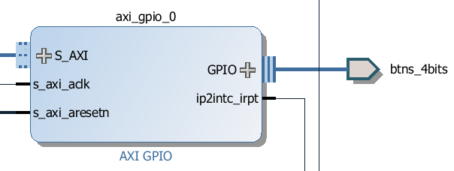
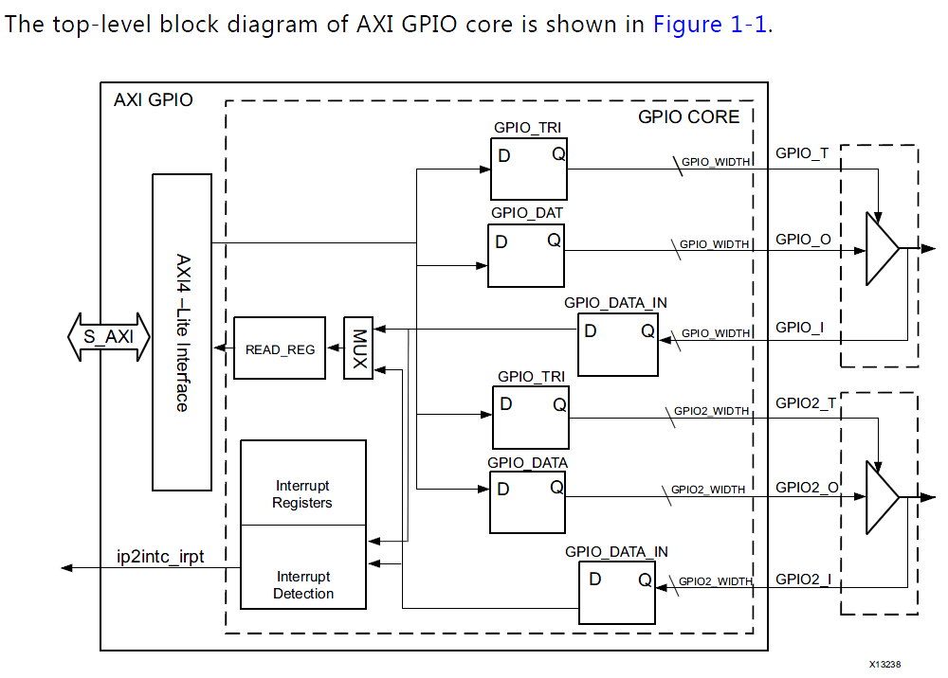
AXI GPIO Core
Reference: AXI GPIO v2.0, LogiCORE IP Product Guide, Vivado Design Suite, PG144 November 18, 2015
Two Channels
Data Registers to store data written to port, not used for input port
Each I/O pin of the AXI GPIO is individually programmable as an input or output.
0 = I/O pin configured as output.
1 = I/O pin configured as input.
AXI GPIO v2.0, PG144 November 18, 2015

Slide 27
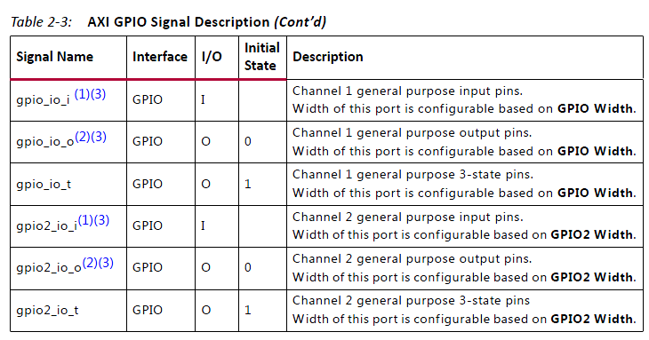
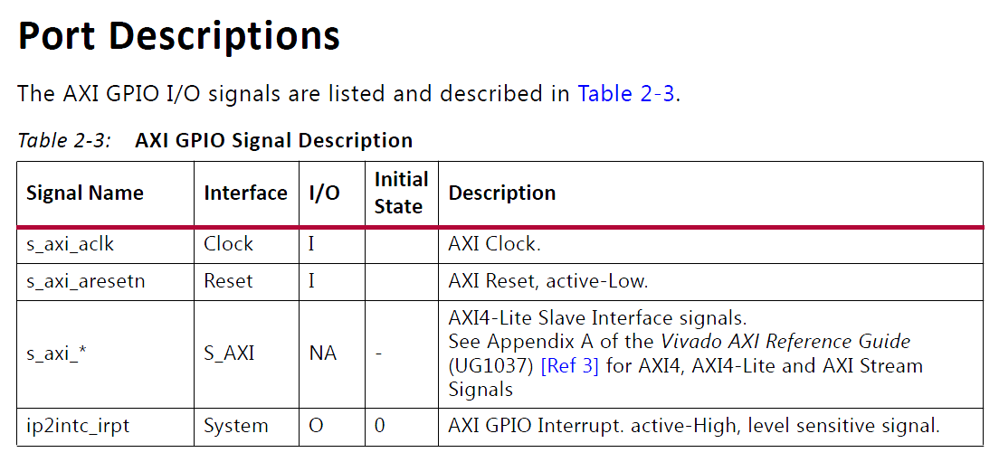
AXI GPIO Ports and Interrupt: Port Pin Change Interrupt
Ip2intc_irpt AXI GPIO Interrupt output pin
Active-High, Level Sensitive Signal
If the interrupt is enabled, a transition on any input causes a level interrupt
AXI GPIO v2.0, PG144 November 18, 2015

Slide 28
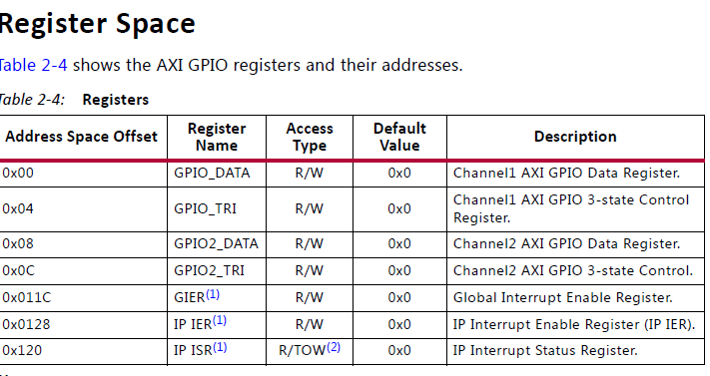
AXI GPIO Register Space
GIER – Global Interrupt Enable Register
IP IER – IP Interrupt Enable Register
IP ISR – IP Interrupt Status Register
AXI GPIO v2.0, PG144 November 18, 2015

Slide 29
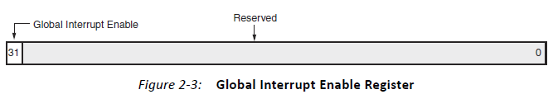
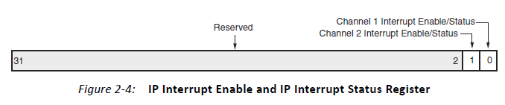
AXI GPIO Interrupt Registers
Global Interrupt Enable Register (GIER) – one bit register
Bit 31 is used to enable interrupt: 1 to enable and 0 to disable interrupt
void XGpio_InterruptGlobalEnable(XGpio *InstancePtr);
void XGpio_InterruptGlobalDisable(XGpio *InstancePtr);
IP Interrupt Enable Register (IP IER) – Implements the independent interrupt enable bit for each channel.
Bit 0 for Channel 1
Bit 1 for Channel 2
AXI GPIO v2.0, PG144 November 18, 2015

Slide 30
AXI GPIO Interrupt Registers
void XGpio_InterruptEnable(XGpio *InstancePtr, u32 Mask);
void XGpio_InterruptDisable(XGpio *InstancePtr, u32 Mask);
IP Interrupt Status Register (IP ISR) – Implements the independent interrupt status bit for each channel. The IP ISR provides Read and Toggle-On-Write access.
Bit 0 for Channel 1 – 1 to flag interrupt and 0 to indicate no interrupt
Bit 1 for Channel 2 - 1 to flag interrupt and 0 to indicate no interrupt
void XGpio_InterruptClear(XGpio *InstancePtr, u32 Mask);
u32 XGpio_InterruptGetEnabled(XGpio *InstancePtr);
u32 XGpio_InterruptGetStatus(XGpio *InstancePtr);
AXI GPIO v2.0, PG144 November 18, 2015

Slide 31
AXI Timers – Implemented on FPGA fabric
Reference: AXI Timer v2.0, LogiCORE IP Product Guide, Vivado Design Suite, PG079 November 18, 2015
The LogiCORE™ IP AXI Timer/Counter is a 32/64-bit timer module that interfaces to the AXI4-Lite interface.
Two programmable interval timers with
interrupt, event generation, and event capture capabilities
Configurable counter width
One Pulse Width Modulation (PWM) output
Cascaded operation of timers in generate and capture modes
The clock rate of the timer modules is s_axi_aclk (no prescaling of the clock is performed)
Interrupt on Timer overflow, either counting up or down.
Timer counts up by default
AXI Timer v2.0, PG079, November 18, 2015

Slide 32
AXI Timers on FPGA Fabric
AXI4-Lite Interface:
The AXI4-Lite Interface module implements an AXI4-Lite slave interface for accessing memory mapped Timer registers. For details about the AXI4-Lite slave interface.
Timer Registers:
The Register block implements a set of 32-bit registers for each timer/counter. This set of register contains load register, timer/counter register and control/status register.
32-bit Counters:
The Timer/Counter module has two 32-bit counters, each of which can be configured for up/down counts and can be loaded with a value from the load register.
Interrupt Control:
The Interrupt control module generates a single interrupt depending on the mode of operation.
AXI Timer v2.0, PG079, November 18, 2015

Slide 33
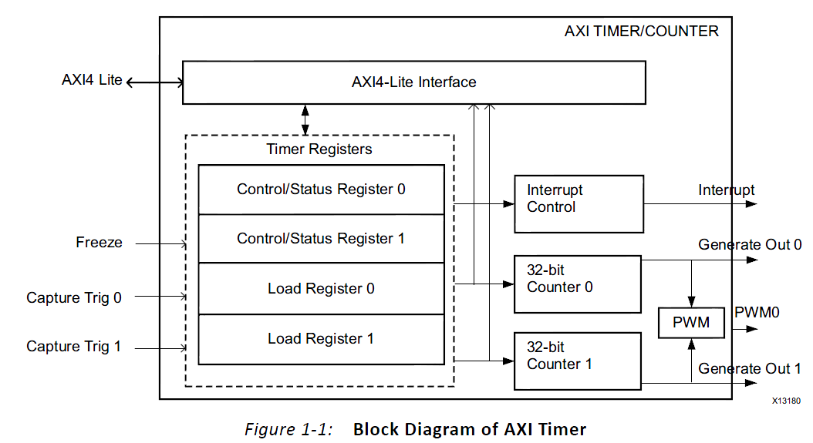
AXI Timers on FPGA Fabric
Pulse Width Modulation (PWM):
The PWM block generates a pulse signal, PWM0, with a specified frequency and duty factor. It uses Timer 0 for PWM0 period, and Timer 1 for PWM0 output width.
The clock rate of the timer modules is s_axi_aclk (no prescaling of the clock is performed)
AXI Timer v2.0, PG079, November 18, 2015

Slide 34
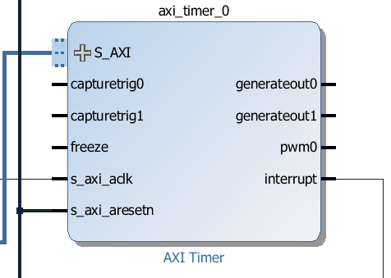

Slide 35
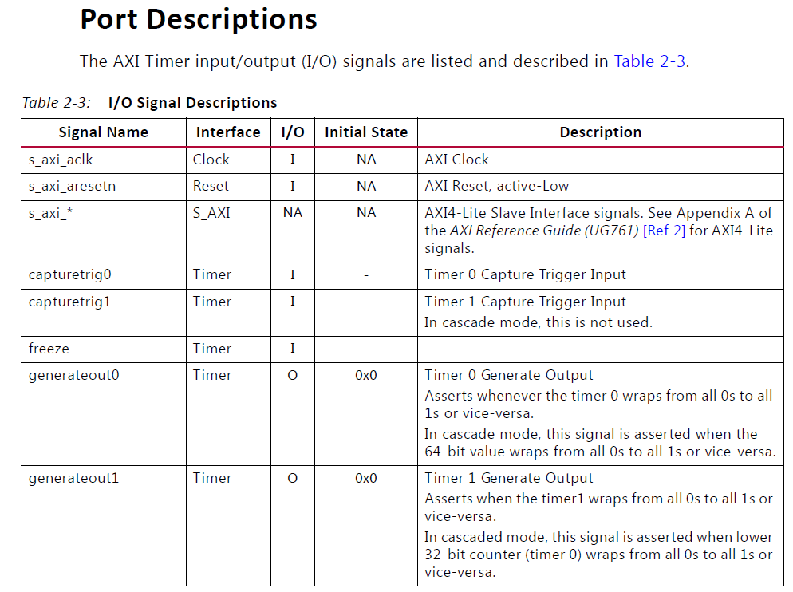
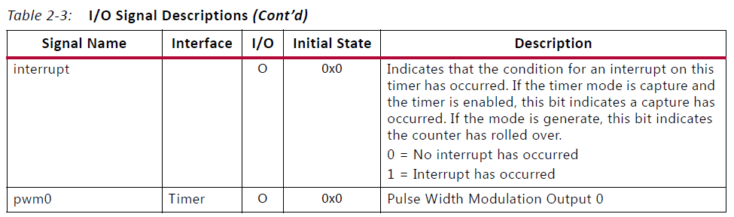
AXI Clock
AXI active low reset
Input captures
Overflow flags
Interrupt
PWM output
AXI Timer v2.0, PG079, November 18, 2015

Slide 36
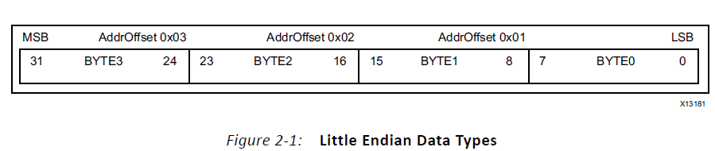
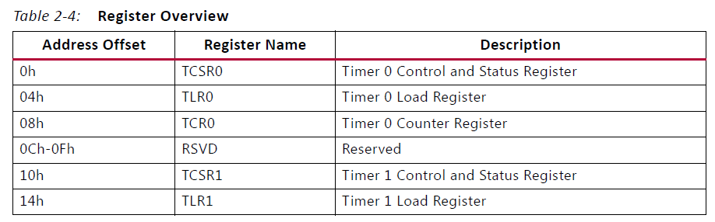
AXI Timers: Registers
TCR0 and TCR1
Timer/Counter accessible in Byte (8 bits) , Half Word (16 bits), Word (32 bits)
TCSR0 and TCSR1
TLR0 and TLR1
AXI Timer v2.0, PG079, November 18, 2015

Slide 37
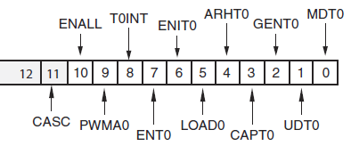
AXI Timers: Timer Control/Status Register 0
CASC – cascade mode
ENALL – Enable all timers when writing 1 to it to make ENT0=1 and ENT1=1.
PWMA0 – Enable PWM
T0INT – interrupt flag, write “1” to clear it
ENT0 – Enable Timer 0
ENIT0 – Enable Timer 0 interrupt
LOAD0 – load Timer 0 with value in TLR0
ARHT0 – Auto reload/hold Timer 0
CAPT0 – Enable external capture trigger
GENT0 – Enable external generate signal
UDT0 – Up/Down counting
MDT0 – Counter/Capture mode

Slide 38
AXI Timers Driver Functions, xtmrctr.h, xtmrctr.c under tmrctr_v3.c
int XTmrCtr_Initialize(XTmrCtr * InstancePtr, u16 DeviceId);
void XTmrCtr_Start(XTmrCtr * InstancePtr, u8 TmrCtrNumber);
void XTmrCtr_Stop(XTmrCtr * InstancePtr, u8 TmrCtrNumber);
u32 XTmrCtr_GetValue(XTmrCtr * InstancePtr, u8 TmrCtrNumber);
void XTmrCtr_SetResetValue(XTmrCtr * InstancePtr, u8 TmrCtrNumber, u32 ResetValue);
u32 XTmrCtr_GetCaptureValue(XTmrCtr * InstancePtr, u8 TmrCtrNumber);
int XTmrCtr_IsExpired(XTmrCtr * InstancePtr, u8 TmrCtrNumber);
void XTmrCtr_Reset(XTmrCtr * InstancePtr, u8 TmrCtrNumber);
XTmrCtr_Config *XTmrCtr_LookupConfig(u16 DeviceId);

Slide 39
AXI Timers Driver Functions, xtmrctr.h, xtmrctr.c under tmrctr_v3.c
void XTmrCtr_SetOptions(XTmrCtr * InstancePtr, u8 TmrCtrNumber, u32 Options);
u32 XTmrCtr_GetOptions(XTmrCtr * InstancePtr, u8 TmrCtrNumber);
void XTmrCtr_GetStats(XTmrCtr * InstancePtr, XTmrCtrStats * StatsPtr);
void XTmrCtr_ClearStats(XTmrCtr * InstancePtr);
int XTmrCtr_SelfTest(XTmrCtr * InstancePtr, u8 TmrCtrNumber);
void XTmrCtr_SetHandler(XTmrCtr * InstancePtr, XTmrCtr_Handler FuncPtr,
void *CallBackRef);
void XTmrCtr_InterruptHandler(void *InstancePtr);

Slide 40
To Clear Interrupt Flag: void XTmrCtr_Start(); in xtmrctr.c
/*Starts the specified timer counter of the device such that it starts running. The timer counter is reset
before it is started and the reset value is loaded into the timer counter.*/
void XTmrCtr_Start(XTmrCtr * InstancePtr, u8 TmrCtrNumber)
{
u32 ControlStatusReg;
Xil_AssertVoid(InstancePtr != NULL);
Xil_AssertVoid(TmrCtrNumber < XTC_DEVICE_TIMER_COUNT);
Xil_AssertVoid(InstancePtr->IsReady == XIL_COMPONENT_IS_READY);
/* Read the current register contents such that only the necessary bits of the register are modified in the following operations */
ControlStatusReg = XTmrCtr_ReadReg(InstancePtr->BaseAddress, TmrCtrNumber, XTC_TCSR_OFFSET);
/* Reset the timer counter such that it reloads from the compare register and the interrupt is cleared simultaneously, the interrupt can only be cleared after reset such that the interrupt condition is cleared */
XTmrCtr_WriteReg(InstancePtr->BaseAddress, TmrCtrNumber, TC_TCSR_OFFSET, XTC_CSR_LOAD_MASK);
/* Indicate that the timer is started before enabling it */
if (TmrCtrNumber == 0) { InstancePtr->IsStartedTmrCtr0 = XIL_COMPONENT_IS_STARTED;
} else { InstancePtr->IsStartedTmrCtr1 = XIL_COMPONENT_IS_STARTED; }
/* Remove the reset condition such that the timer counter starts running with the value loaded from the compare register */
XTmrCtr_WriteReg(InstancePtr->BaseAddress, TmrCtrNumber, XTC_TCSR_OFFSET,
ControlStatusReg | XTC_CSR_ENABLE_TMR_MASK);
}

Slide 41
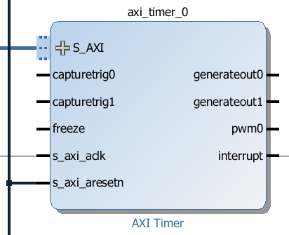
AXI Timers: xtmrctr_intr.h, xtmrctr_intr.c
void XTmrCtr_SetHandler(XTmrCtr * InstancePtr, XTmrCtr_Handler FuncPtr, void *CallBackRef);
void XTmrCtr_InterruptHandler(void *InstancePtr);
Clear interrupt flag T0INT in TCSR0 Register by calling
void XTmrCtr_Start(XTmrCtr * InstancePtr, u8 TmrCtrNumber);
Starts the specified timer counter of the device such that it starts running.
The timer counter is reset before it is started and the reset value is loaded into the timer counter.
This is a count-up timer
AXI Timer v2.0, PG079, November 18, 2015

Slide 42
interrupt_counter_2D.c: Setup AXI Timer
//Interrupt interval is 1.34 seconds
//0xF8000000=4,160,749,568,
//Timer counts up by default at 100MHz clock
//Number of clock periods before overflow is
//0x07FFFFFF=134,217,727 => 1.34 seconds
#define TMR_LOAD 0xF8000000
XTmrCtr TMRInst;
//----------------------------------------------------
// SETUP THE TIMER
//----------------------------------------------------
status = XTmrCtr_Initialize(&TMRInst, TMR_DEVICE_ID);
if(status != XST_SUCCESS) return XST_FAILURE;
XTmrCtr_SetHandler(&TMRInst, TMR_Intr_Handler, &TMRInst);
XTmrCtr_SetResetValue(&TMRInst, 0, TMR_LOAD);
XTmrCtr_SetOptions(&TMRInst, 0, XTC_INT_MODE_OPTION | XTC_AUTO_RELOAD_OPTION);
AXI GPIO v2.0, PG144 November 18, 2015

Slide 43
interrupt_counter_2D.c: AXI Timer Interrupt Handler
static int tmr_count;
//this code will NOT work as it was intended
//because the interrupt flag will not be cleared unless tmr_count==3
//therefore, this handler will be called three times for each interrupt
void TMR_Intr_Handler(void *data)
{
if (XTmrCtr_IsExpired(&TMRInst,0)){
// Once timer has expired 3 times, stop, increment counter
// reset timer and start running again
if(tmr_count == 3){
XTmrCtr_Stop(&TMRInst,0);
tmr_count = 0;
led_data++;
XGpio_DiscreteWrite(&LEDInst, 1, led_data);
XTmrCtr_Reset(&TMRInst,0);
XTmrCtr_Start(&TMRInst,0);
}
else tmr_count++;} }
AXI GPIO v2.0, PG144 November 18, 2015

Slide 44
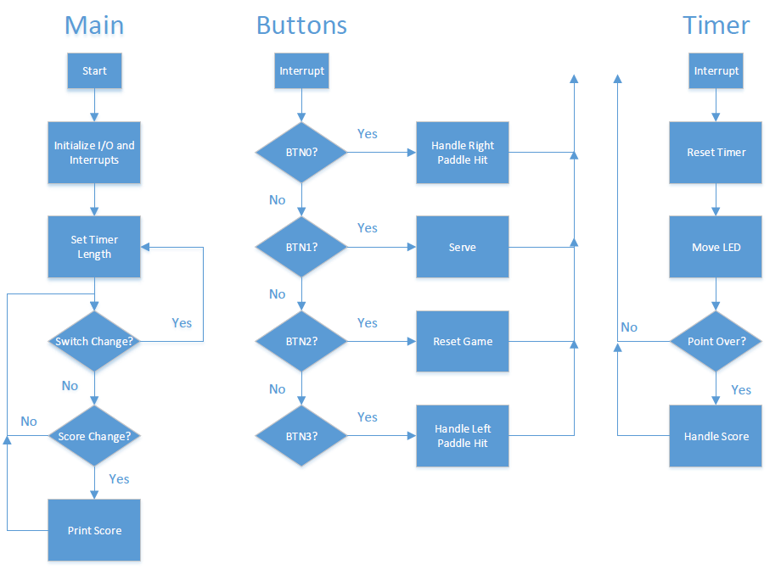
Lab #8 Interrupt-Driven LED Ping-Pong Game: David Mehl’s Code

Slide 45
Lab #8 Interrupt-Driven LED Ping-Pong Game: David Mehl’s Code
2 * pingPong.h
9
10 #ifndef PINGPONG_H_
11 #define PINGPONG_H_
12
14 #define PLAYER_1_PADDLE 0
15 #define PLAYER_2_PADDLE 3
16 #define SERVE_BUTTON 1
17 #define RESET_BUTTON 2
18
19 #define BLANK 0
20
21 typedef enum {
22 LEFT, RIGHT
23 } direction_t;
24
25 typedef enum {
26 NONE, EARLY, MISS, HIT
27 } hit_status_t;
28
29 typedef enum {
30 SERVE_LOCATION_RIGHT = -1, ZERO = 0, ONE, TWO, THREE, SERVE_LOCATION_LEFT
31 }location_t;
33 typedef enum {
34 NO_NEW_DATA, NEW_DATA
35 } game_change_t;
36
37 typedef enum {
38 STOP, GO
39 }game_state_t;
40
41 typedef struct {
42 direction_t direction;
43 location_t location;
44 uint32_t scorePlayer1;
45 uint32_t scorePlayer2;
46 hit_status_t hitPlayer1;
47 hit_status_t hitPlayer2;
48 game_change_t changed;
49 game_state_t state;
50 } GameStruct;
53
54 #endif /* PINGPONG_H_ */

Slide 46
Lab #8 Interrupt-Driven LED Ping-Pong Game: David Mehl’s Code
int main(void) {
47 gsptr->direction = RIGHT;
48 gsptr->location = THREE;
49 gsptr->scorePlayer1 = 0;
50 gsptr->scorePlayer2 = 0;
51 gsptr->hitPlayer1 = NONE;
52 gsptr->hitPlayer2 = NONE;
53
54 XTmrCtr *TimerInstancePtr = &timer;
55 int dip_check, dip_check_prev, status;
56
57 xil_printf("-- Start of the Program --\r\n");
58
59 XGpio_Initialize(&dip, XPAR_SWITCHES_DEVICE_ID);
60 XGpio_SetDataDirection(&dip, 1, 0xffffffff);
61
62 XGpio_Initialize(&push, XPAR_BUTTONS_DEVICE_ID);
63 XGpio_SetDataDirection(&push, 1, 0xffffffff);
64
65 dip_check_prev = XGpio_DiscreteRead(&dip, 1);
66 timerLoadValue = (ONE_LED * dip_check_prev) + TMR_BASE;
67 status = timerInit();
68 status = intcInit(&push);
69 if (status == XST_SUCCESS) {
70 #ifdef DEBUG
71 xil_printf("Successfully Initialized Timer\r\n");
72 #endif
73 } else {
74 #ifdef DEBUG
75 xil_printf("### Failed to initialize Timer ###\r\n"); #endif
77 return XST_FAILURE;
78 }
80 if (status == XST_SUCCESS) {
81 #ifdef DEBUG
82 xil_printf("Successfully Initialized Interrupts\r\n"); #endif
84 } else {
85 #ifdef DEBUG
86 xil_printf("### Failed to initialize Interrupts ###\r\n"); #endif
88 return XST_FAILURE;
89 }
91 resetGame(gsptr);
92 XTmrCtr_Start(TimerInstancePtr, TIMER_NUMBER);
94 // Check for switch changes and update timer accordingly
95 while (1) {
96 dip_check = XGpio_DiscreteRead(&dip, 1);
97 if (dip_check != dip_check_prev) {
98 timerLoadValue = dip_check * ONE_LED + TMR_BASE;
99 dip_check_prev = dip_check;
100 }
101 if (gsptr->changed != NO_NEW_DATA) {
102 xil_printf("Player 1: %d | Player 2: %d\r\n",
103 (unsigned int) gsptr->scorePlayer1,
104 (unsigned int) gsptr->scorePlayer2);
105 gsptr->changed = NO_NEW_DATA;
106 }
108 return 0; }
Notes:
David Mehl has been working for Tesla as an intern and plans to join Tesla after spring 2017

